Slide 1


Graduate
Experience
at GovState
Jason Vignone
Director of Graduate Admissions & Retention
(708) 235-7325
jvignone@govst.edu

Slide 2


Welcome!
Topics to be Covered:
About Gov State
Benefits of Graduate Degrees
Choosing the Right Program
Tuition and Funding Opportunities
Application Process
Next Steps for Admitted Students
Questions?

Slide 3

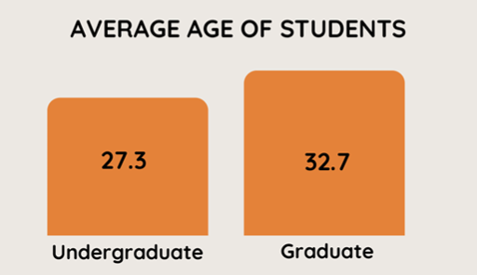
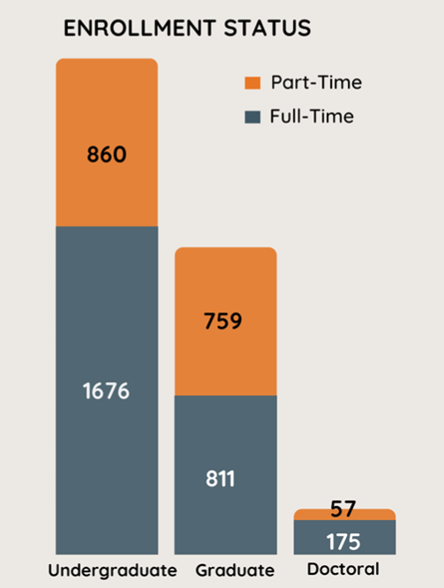
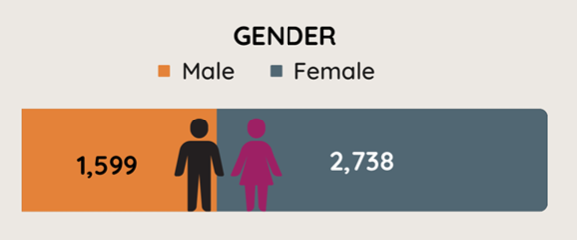
GovState Quick Facts
- Diverse Faculty, Staff, and Students
Culturally, Economically, Generationally
*As of September 2023, See “Fast Facts” at https://www.govst.edu/about/

Slide 4
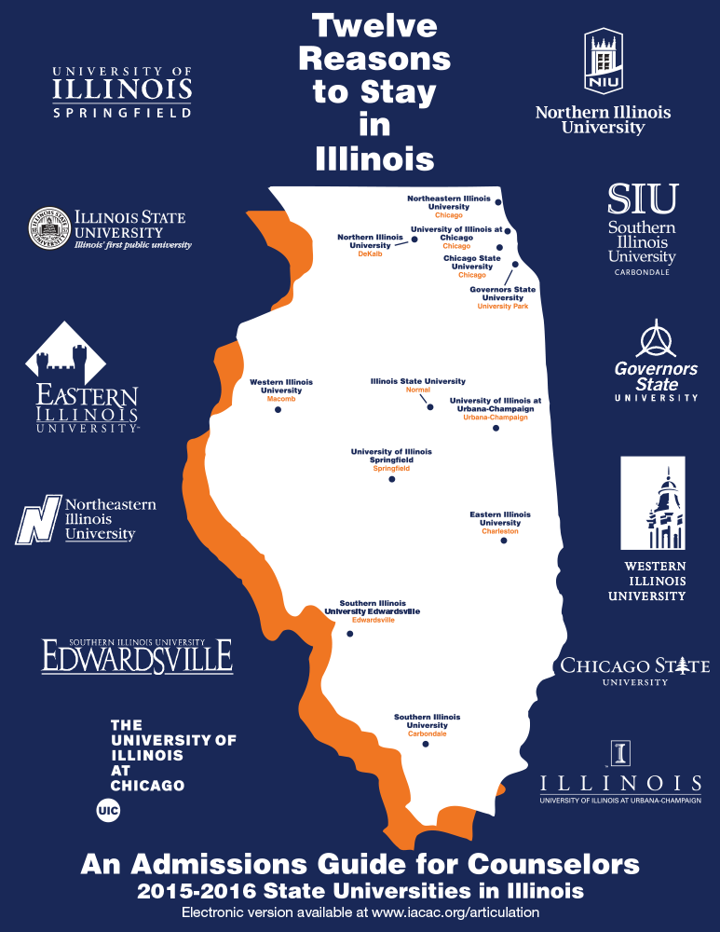



GovState Quick Facts
- Founded in 1969
“The Place Where You Finish What You Started”
- Public Illinois State Institution
- Accredited
- Higher Learning Commission (HLC)
- Illinois Board of Higher Education
- Program-Specific Accreditations https://www.govst.edu/accreditation/
- 750 acres of Prairie
- 12:1 Student-Faculty Ratio
- 62,000 alumni
- 4,338 Enrolled Students
Fall 2024

Slide 5

GovState Quick Facts: Grad
- 62 Graduate Programs
Masters, Doctoral, Certificate Programs
- 4 academic Colleges and the College of Graduate Studies
College of Arts and Sciences
College of Business
College of Education
College of Health and Human Services
- Graduate Population = 40.8% of all students
Undergrad
Masters
Doctoral

Slide 6

Benefits of Graduate Degrees
Advancing Your Career:
Some Careers require/prefer a Master’s Degree
Psychologist, Social Work, Counseling, Principal, Occupational Therapist,
Speech Pathologist
Some Careers require/prefer a Doctoral Degree
Physical Therapist, Superintendent, College Professor
Increased Earning Potential
Average earnings with a master’s degree+ is 20% higher than bachelor’s degree
National Center for Education Statistics, 2022 report

Slide 7

What to Consider When Choosing a Graduate Program
The School Itself
Location, Student Resources
Program Format
Online or In-Peron, Schedule and Timeline, Class Sizes
Faculty, Mentors, and Alumni Network
Real-world experience, connections, willingness to support you
Accreditation or Licensure Outcomes
Will this program align with your expected outcomes?
Cost
Tuition, Fees, Scholarships, Transportation

Slide 8

Why GovState?
Small Class Sizes
The average Graduate class size is 12-14 students.
Hands- On Experiential Learning
Many opportunities for real world experience available to students.
Flexible Schedules and Delivery Formats
Evening, Online, and Hybrid options for most classes/programs
Easy to get to
I-57, I-80, Metra Station
Safest public university campus in Illinois and Northwest Indiana
*National Center for Education Statistics

Slide 9
Award Winning Faculty
Experienced Industry Leaders
Many studied at top universities (Northwestern University, NYU, McGill, and the University of Chicago)
Many are still practicing in their field in addition to teaching
Allows them to discuss current, relevant, real-world experiences
Popular Podcasts, YouTube Creators, and Influencers in their industry
Published Authors
Key-note speakers and Expert Panelists at National and International Conferences
Award Winning Faculty:
“Professor Fraud” - Tax Fraud Expert
Bill Kresse, JD, CPA, CFE - Accounting
Emmy-Award winners
Yvette Brown (producer) – Media Studies
Tony Labriola (producer, director) - Media Studies, Communication
For More Highlights: https://gsunews.govst.edu/faculty-experts/
For Program Specific Faculty Profiles: Program Web Page → Meet our Faculty

Slide 10
Supportive Student Resources
We’re here to help you, even on the hard days.
Our goal is not just to enroll students, but to see you through to graduation & success.
Campus Support Services & Resources
ASSD - Access Services for Students with Disabilities
Academic Resource Center (Tutoring)
Campus Library and Research Assistance
Career Services
Computer and IT Services (The Cube)
Counseling and Wellness Center
GPN – Graduate Professional Network
LatinX Resource Center
Recreation and Fitness Center
Veterans Services
Writing Services
And MORE

Slide 11

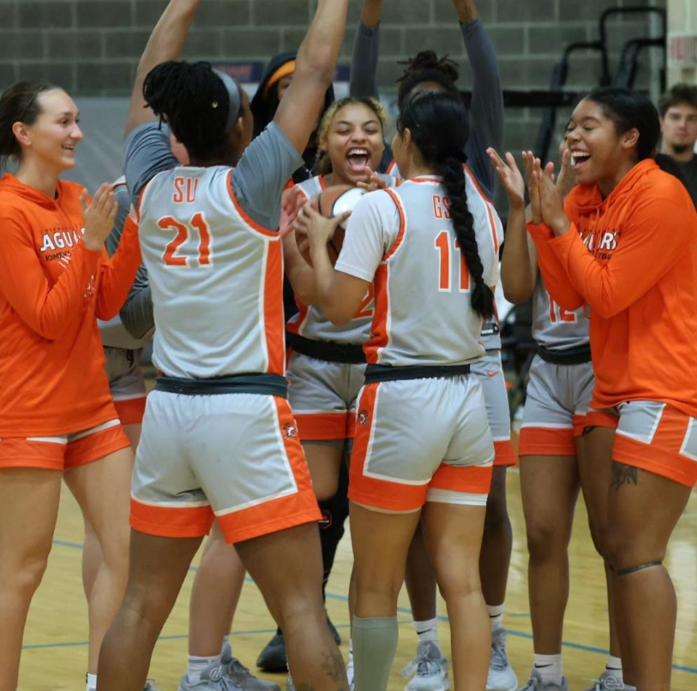
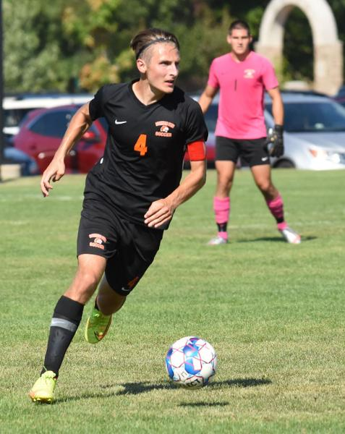
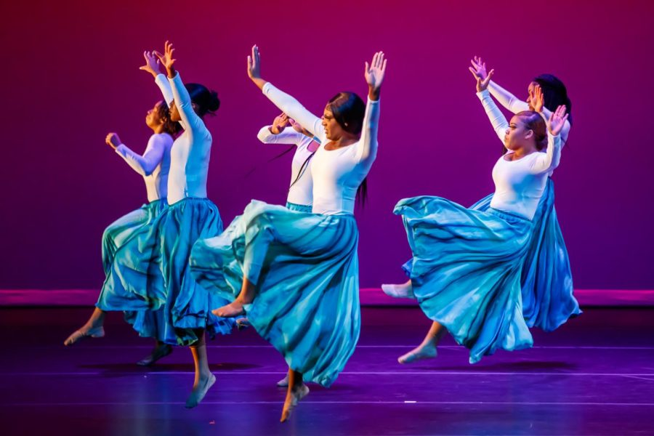
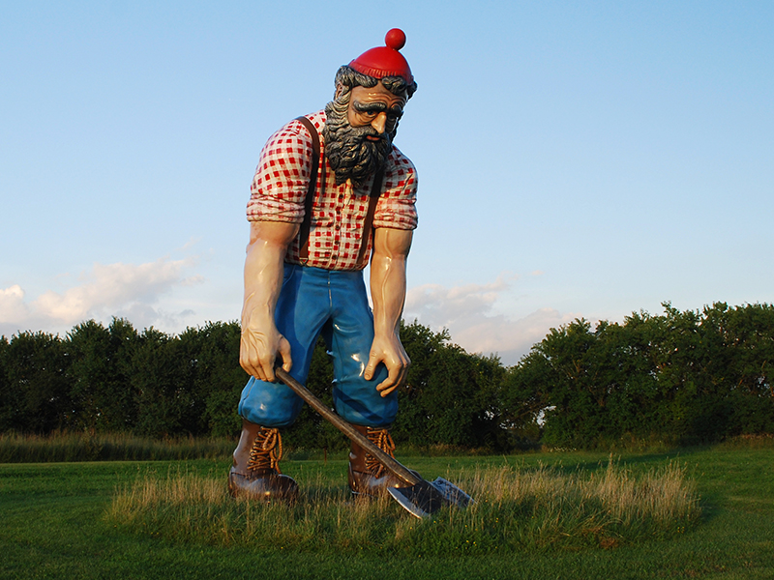

Campus Life
Athletics
Undergrad and graduate athletes
Free tickets
Center for Performing Arts
Discounted Tickets
Nathan Manilow Sculpture Park
Free
Student Events
Welcome Week
Homecoming
Student Activities Council
Finals and Midterm Events
Student Club/Org Events

Slide 12
45+ Student Clubs and Organizations
Hobbies and Affinity Groups
ArtForum
Jaguars Anime and Gaming Club
Pheonix Newspaper
Drone Engineering
GSU Music Company
Hall of Faith
Computer Technology Club
Cyber Defense Club
Fatal Dance Academy
Bowling Club
Cheer Squad
Dance Company
Greek Life
Innovation Club
Drill Team
Music Company
Reconstructured
Chess
Soccer
Student Veterans Association
Table Tennis Club
Writers Union
Cultural Affinity Groups
Association of Latin American Students
Black Student Union
Chinese Student Association
International Culture Organization
Muslim Student Association
Indian Student Organization
Social Change, Volunteerism
Generating Hope
Sustainability Club
Male Success Initiative
New Student Peer Mentors
Several Honor Societies
Typically require 3.75 GPA in Graduate Studies
Academic/Professional Organizations
Accounting, Finance, Economics Club
Allied Health Profession
Biology Club
CEO Leadership Program
Coalition of Occupational Therapy Advocates for Diversity
Supply Chain Student Club
Management Information Systems
National Society of Leadership Success
National Student Speech Language and Hearing Association
Physical Therapy Student Association
Pre-Health Club
Social Work Student Organization
Student Education Association
Students of Addictions Studies

Slide 13

Graduate Professional Network
Mission:
The GSU-GPN represents and supports the interests of the University’s graduate student community by supporting scholarly activities and providing opportunities for professional development. The GPN serves as a liaison between the graduate student body and the administration to encourage communication and cooperation.
Activities:
Networking Events
Professional Development Workshops
Recreational Athletics
Social Events
Resources:
Resource Library in Blackboard to guide graduate students
Advocate for graduate student needs and interests

Slide 14

Affordable Tuition
Average National Cost of Graduate Tuition and Fees is $21,730 per year*
*Based on National Postsecondary Student Aid Survey from BestColleges.com, includes both public and private institutions
Many GSU students can save 25% - 50% compared to similar programs
GSU Average Cost of Attendance Per Year:
9 Credit Hours: $11,374.00
6 Credit Hours: $6,958.00
Tuition Calculator: https://www.govst.edu/tuition
*Tuition Rates are subject to change

Slide 15

Questions so far?
Topics Still to Come:
Funding Graduate School
How to Apply

Slide 16


Financial Aid for Graduate Students
Scholarships
Student Employment Opportunities
FWS
Graduate Assistantships
Loans
Talk to the Experts: Financial Aid Office
faid@govst.edu
708.534.4480

Slide 17
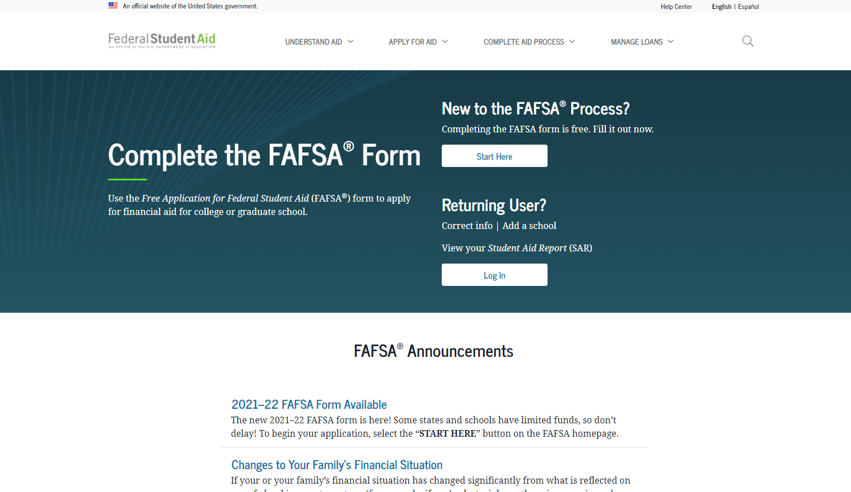
How Do I Apply for Financial Aid?
Have you done the #FAFSA?
FREE Application for Federal Student Aid
Found online at studentaid.gov
Direct Link: (https://studentaid.gov/h/apply-for-aid/fafsa)
Fall 2025 Enrollment
2025-2026 FAFSA Form
Financial Aid Office
faid@govst.edu
708.534.4480

Slide 18
Graduate Student Loans
Federal Loans
Federal Direct Unsubsidized Loans:
Federal Direct Graduate PLUS Loans
If you need additional loans beyond the maximum offered in Direct Unsubsidized Loans
Must be enrolled at least half-time with Financial
FA Link – Use Extra Funds towards textbooks, eligible living expenses, etc
Private Student Loans
Typically Higher interest rate
May have less restrictions
Financial Aid Office
faid@govst.edu
708.534.4480

Slide 19
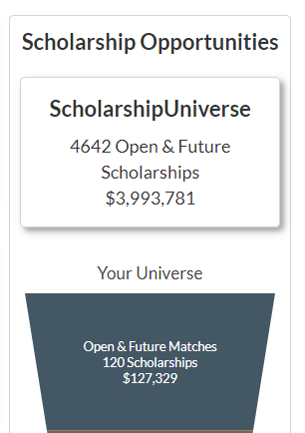
Scholarships
GSU Scholarship homepage: www.govst.edu/Scholarships/
Scholarship Universe: www.govst.scholarshipuniverse.com/public
GSU and External scholarships
All vetted = no questioning if the scholarship is legit
Answer questions to filter opportunities
The more you answer, the better the match
Easily apply online to multiple scholarships
Set up alerts for new scholarship opportunities

Slide 20
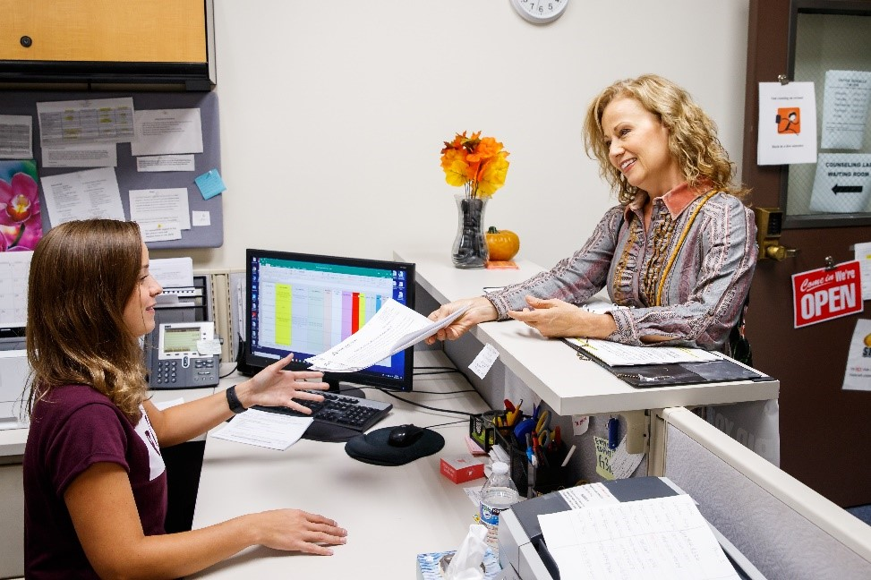
Graduate Assistantships
https://www.govst.edu/employment-resources/
Research Assistant, Teaching Assistant, Office Staff, Event Staff, etc
Work up to 15-20 hours per week in exchange for a stipend and tuition waiver for 6 credits per semester
Search on Jobs For Jaguars (Handshake)

Slide 21
Admission Requirements: Eligibility
All applicants must:
Have been in good standing at the last institution attended.
Masters- Completed/completing a bachelor’s degree
Post-Masters Certificates, Doctoral- Completed a master’s degree before time of enrollment
Program-Specific Requirements can vary. May include:
GPA: most programs list a minimum GPA requirement, typically ranging from 2.5- 3.0 on 4.0 scale
GRE: Optional but not required for most programs
Prerequisites (if applicable)
Conditional Admittance is possible

Slide 22
Application Requirements
Submit:
Online Application: apply.govst.edu/apply
Communications Disorders, Masters Occupational Therapy, Physical Therapy use a different link
All Official Transcripts
Program- Specific Requirements vary. May include:
Recommendation forms (LORs), Personal Statement, Resume, etc (if applicable)
International Students – Must also submit a copy of the biometrics page of passport, and language proficiency scores (IELTS, TOEFL, Duolingo, Pearsons).

Slide 23
Next Steps to Apply
(Optional) Reach out
GraduateAdmission@govst.edu
Virtual 1-1 Admissions Appointment: https://apply.govst.edu/portal/virtualappointments
Complete an application https://www.apply.govst.edu/apply/
Be aware of program deadlines
Submit all necessary documents
Let us know the application is complete at graduateadmission@govst.edu for expedited processing
Complete FAFSA https://studentaid.gov/h/apply-for-aid/fafsa
Check your application portal for application updates

Slide 24
Already Applied?
After Your Application is Reviewed:
Some Programs - Interview
Email Notification – Update available on your application
View Official Decision Letter in Application Portal
If Admitted:
Decision Letter will have Log In Information and Advisor Information
Contact Advisor – Course Selection
Register for Classes
Summer and Fall Registration opens Week of March 17th
Online University Orientation – Application Portal
Program Orientation (If Applicable)
Watch for Emails for Admitted Student - Next Steps Information Sessions

Slide 25
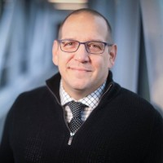
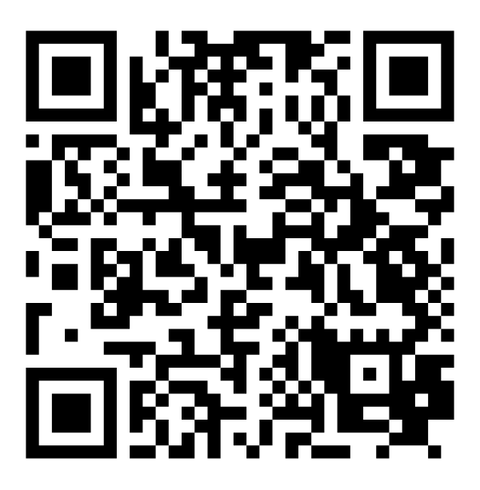
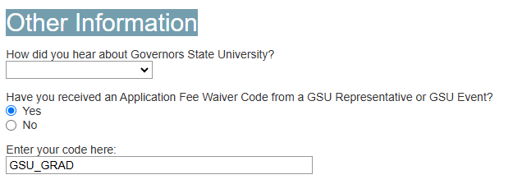
Questions?
Jason Vignone
Director of Graduate Admissions & Retention
(708) 235-7325
jvignone@govst.edu
apply.govst.edu/apply
Application Fee Waiver: GSU_GRAD
Entered on “Application Details” Page
Virtual Appointments

